Slide 1
From Code to Flowcharts
A supplemental lesson for AP CSP

Slide 2
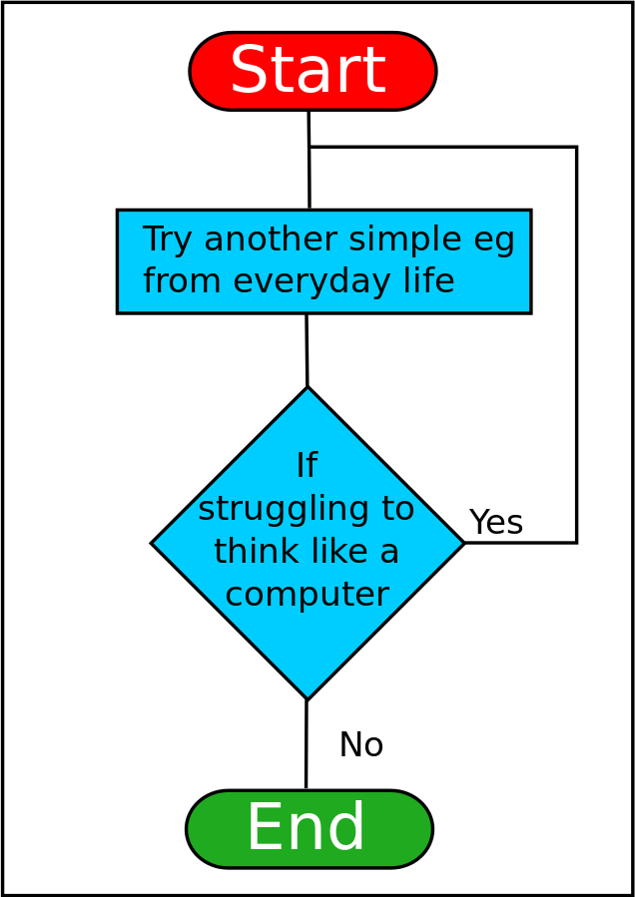
Flowcharts
In the last lesson, you learned about flowcharts. They can help you:
Organize your thoughts and ideas
Use shapes to visualize the solution
Track variables
Identify computations
Look for patterns
Source: https://en.wikiversity.org/wiki/File:ThinkLikeComputerFlowchart.svg

Slide 3
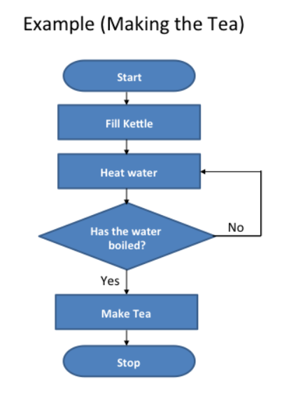
Flowcharts
A flowchart visualizes the algorithm, or how to solve the problem.
It is like a graphic organizer.
There are four common shapes used when creating a flowchart:
Source: https://www.teachwithict.com/flowcharts.html#google_vignette

Slide 4
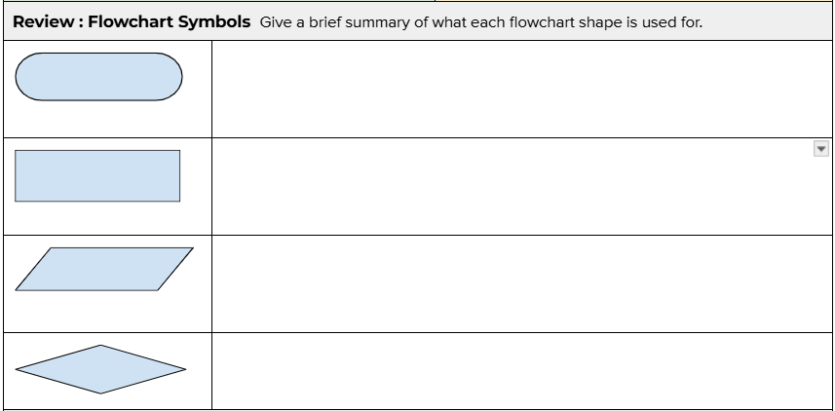
Review: Activity Guide
Fill out the Review in the activity guide.

Slide 5
Flowchart Symbols
Review
Use an oval to mark the beginning and end of the program.
start or stop
Use a parallelogram to show input or output. Input could be the button pressed. Output could be text on the console panel, LEDs lit, a sound played or movement.
input or output
flow lines
Use a rectangle to process an action. It could be used to assign a value to a variable, or increment a counter, or get a random number.
action or process
Use lines to connect the shapes. The arrows show the direction of the steps. Some lines should include labels, such as yes or no, to explain what is happening.
Use a diamond to make decisions. This shape will have two or more lines that come from it – one for each outcome. This step might ask a question or provide options. The result could be true or false, yes or no, or choices (red, blue, or green).
decision

Slide 6
Flowcharts
Now that you have reviewed the flowchart shapes, let’s look at specific examples in Python programming.
Source: https://www.teachwithict.com/flowcharts.html#google_vignette

Slide 7
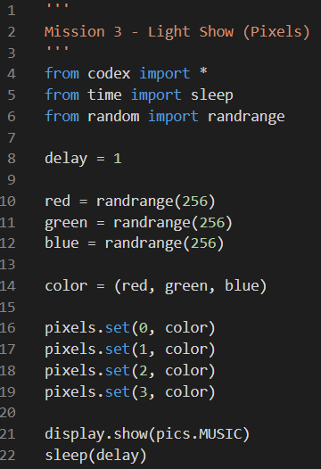
Example #1
start
Can you match the lines of code with the flowchart symbols?
Initialize delay
Assign random numbers to red, green, blue
Assign color (red, green, blue)
Set all pixels to color
Display the music pic & sleep
stop

Slide 8
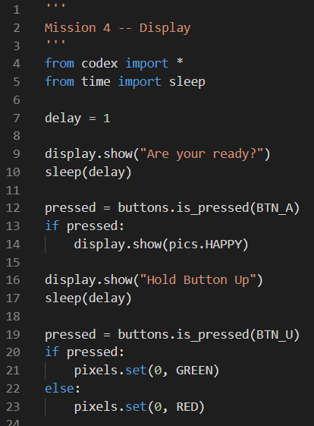
Example #2
Can you match the lines of code with the flowchart symbols?
start
Initialize delay
Display ready message and wait
Assign pressed (button A)
Display happy face pic
yes
Was A pressed?
no
Display button message and wait
Assign pressed (button U)
Pixel 0 green
yes
no
Was U pressed?
Pixel 0 red
stop

Slide 9
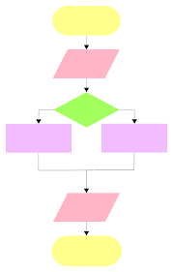
Your Turn!
Create a flowchart from Python code.

Slide 10
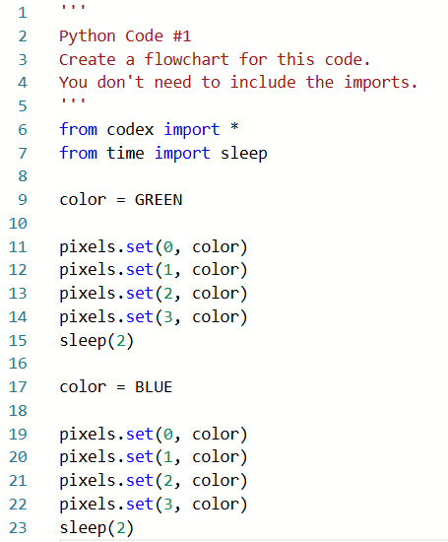
Python Code #1

Slide 11
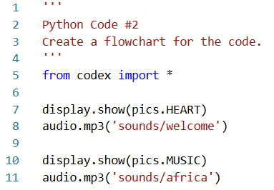
Python Code #2

Slide 12
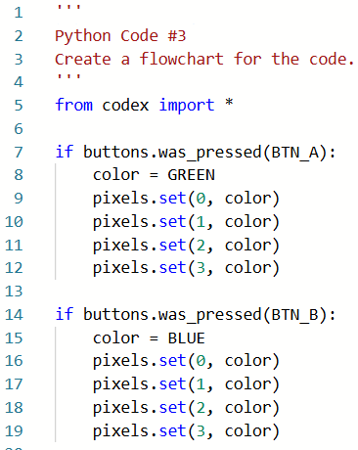
Python Code #3

Slide 13
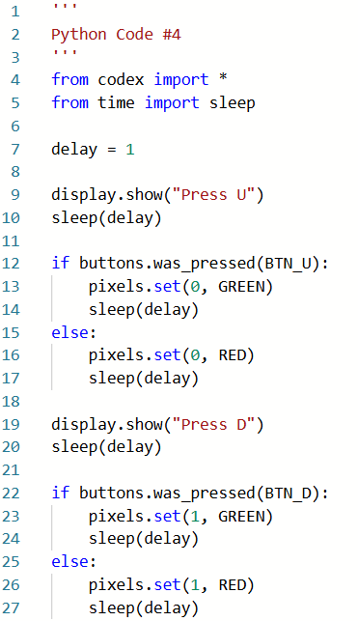
Python Code #4

Slide 14
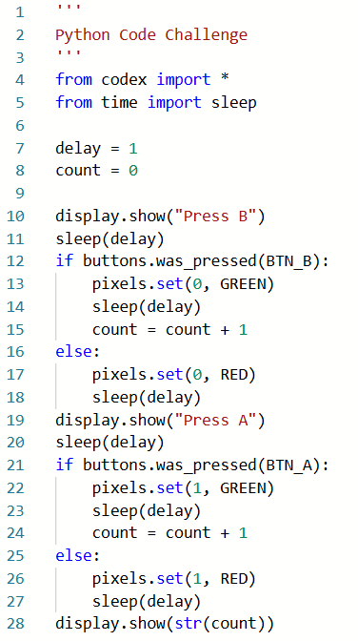
Python Code
Challenge

Slide 15
Flowcharts Summary
Definition: An algorithm is a sequence of steps for completing a task.
Definition: A flowchart is a diagram that uses shapes, lines, and arrows to sequence steps.
Definition: A flowchart is a visual representation of the input, output, decisions, and actions that take place within a program.
Source: https://www.teachwithict.com/flowcharts.html#google_vignette

